Slide 1
Convolutional Neural Networks
John Robinson

Slide 2
Problem Description
Develop a image recognition neural network using a convolutional neural network.

Slide 3
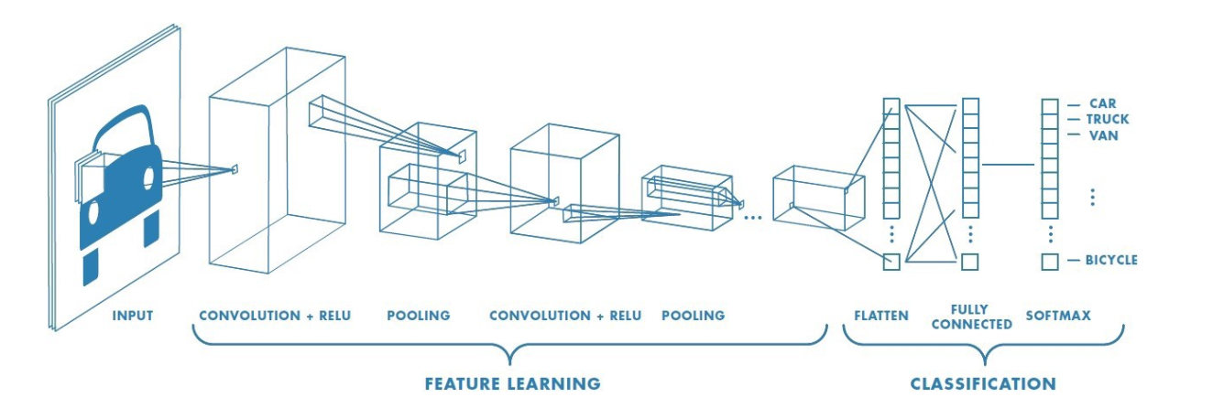
Background: Convolutional Neural Network Overview

Slide 4
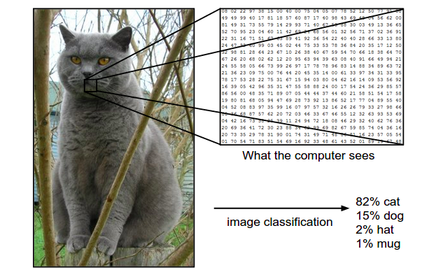
Input Layer

Slide 5
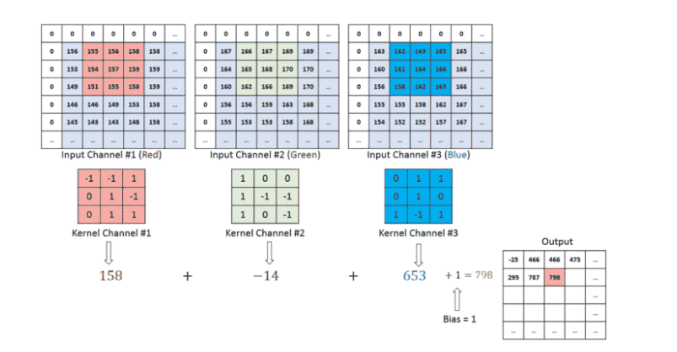
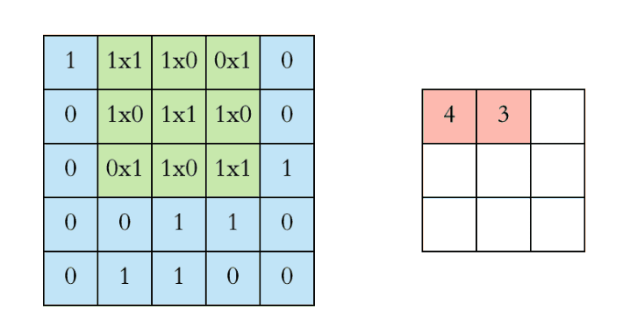
Convolution Layer
The objective of the Convolution Operation is to extract the high-level features such as edges, from the input image
Notes:
Stride, kernel, rgb vs greyscale
The objective of the Convolution Operation is to extract the high-level features such as edges, from the input image.
the first ConvLayer is responsible for capturing the Low-Level features such as edges, color, gradient orientation.
ith added layers, the architecture adapts to the High-Level features as well.
Maybe mention zero padding

Slide 6
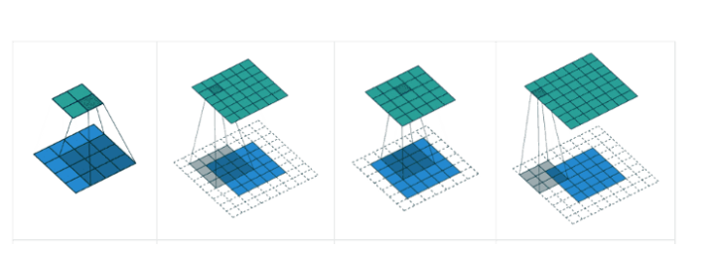
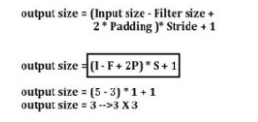
Convolution Layer Cont.
Padding used to add extra pixels, usually zeros to allow for a closer analysis of the input.

Slide 7
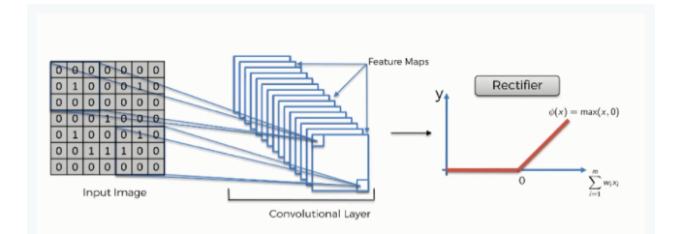
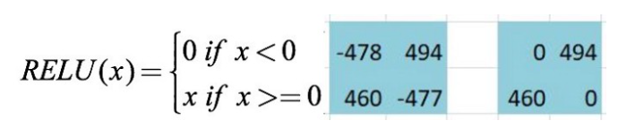

The Rectified Linear Unit: ReLU
ReLU is the max function(x,0) with input x e.g. matrix from a convolved image. ReLU then sets all negative values in the matrix x to zero and all other values are kept constant.

Slide 8
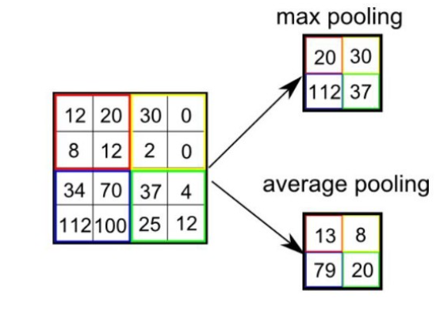
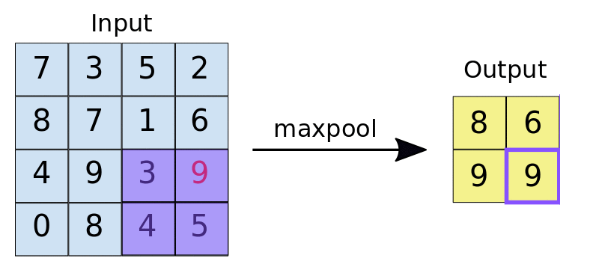
Pooling Layer
The function of pooling is to continuously reduce the dimensionality to reduce the number of parameters and computation in the network. This shortens the training time and controls overfitting
Most frequently used type of pooling is called Max Pooling and used to decrease feature map size while at the same time keeping the significant information.
Notes:
Also average padding in addition to max pooling which just averages instead of taking the max value.
Non overlapping

Slide 9
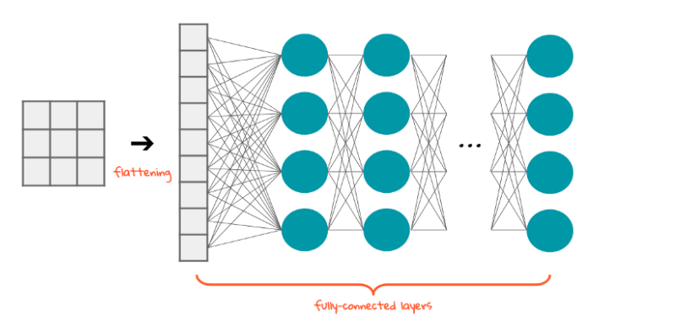
Classification: Flattening Layer
Flattening is the process of converting the result of the convolutional layers into a one dimensional array so that it can connect to the fully connected layer.

Slide 10
Fully Connected Layer
This point becomes a normal neural network with the flattened feature vector is in input for the neural network so must through process of forward and backward propagation
Numbers are randomly generated for bias and weight

Slide 11

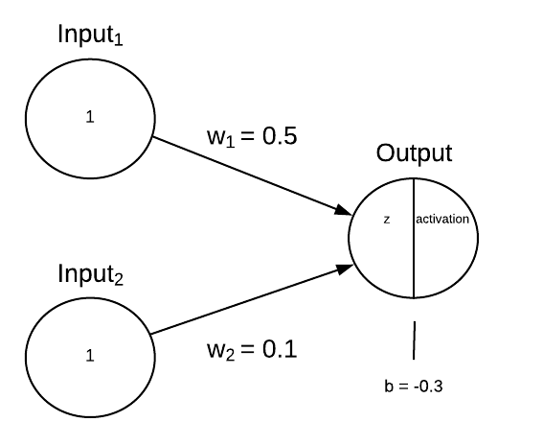


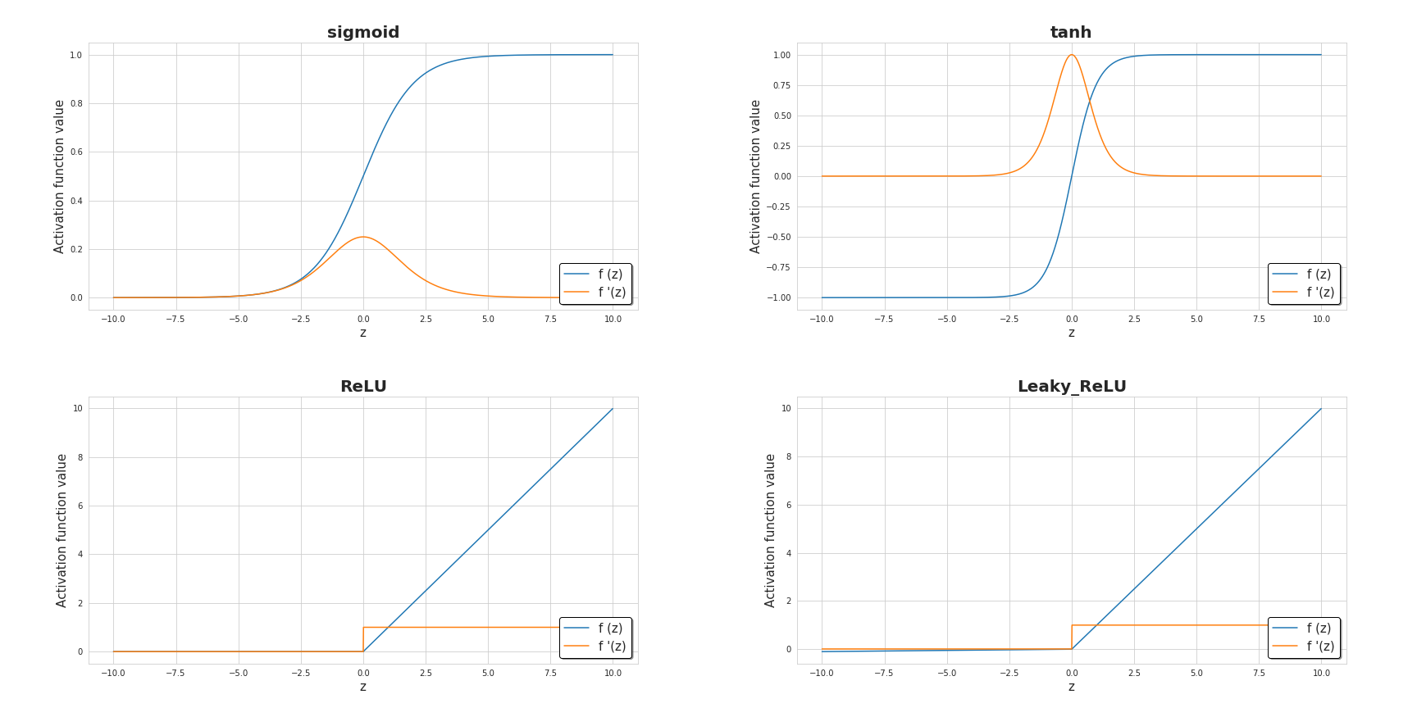
Forward Propagation
Notes:
Sum of previous node times the respective weights plus bias then plugged into activation function yields y this is done until
Actual vs predicted output

Slide 12
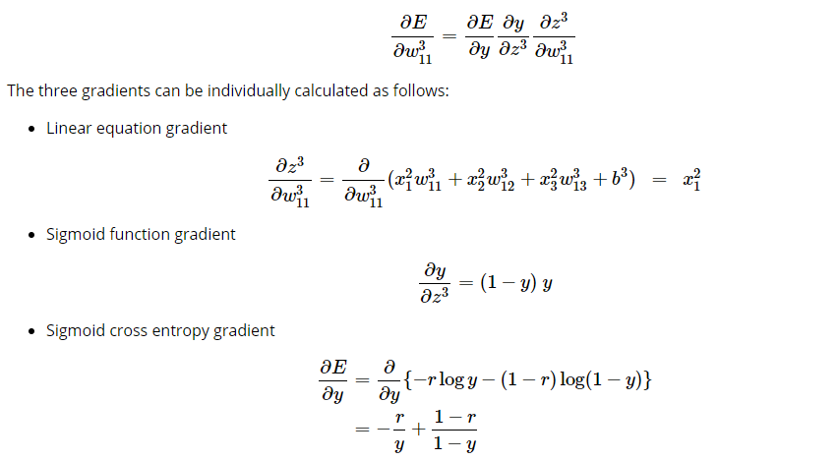

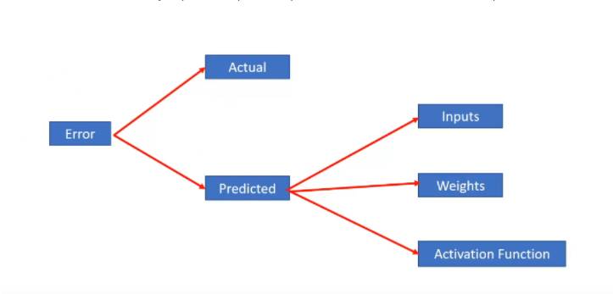
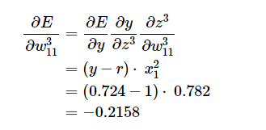
Backward Propagation
Notes:
Loss (output - y)2
Comparing actual vs predicted
mean squared error, binary cross entropy, Categorical Cross Entropy, and Sparse Categorical Cross Entropy
Derivation of the loss in respect to weight through chain rule makes top right
The derivative of the loss function over the weight of the node i equals the derivative of the loss function in respect to the activation function times the derivative of the activation function in respect to the input for node i times the derivative of the input to node i in respect to the weight
The sum of the three derivations is how backpropagation calculates the gradients of the loss in respect to the weights of the network
Next is gradient descent
So the old weight is subtracted from the arbitrary learning rate a which is determined beforehand much like the bias multiplied times the result of the chain rule calculation with the loss function. The result is the new weight. This is done until the local mininia is found

Slide 13
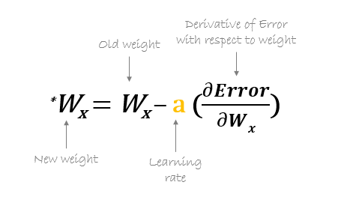
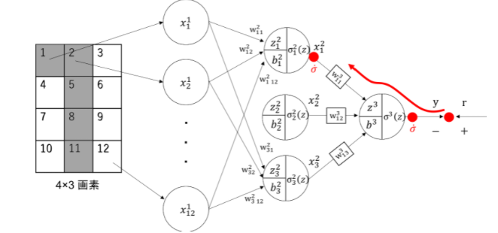

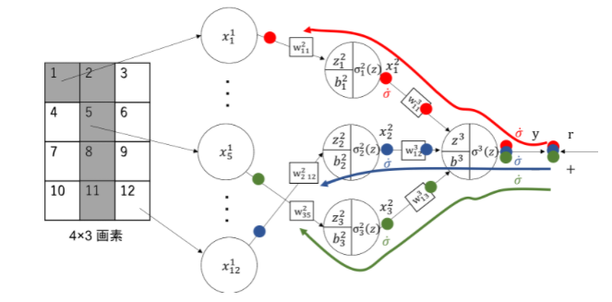
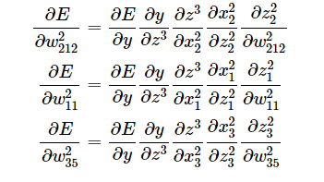
Backward Propagation Cont.

Slide 14
Primary Objective
To make an effective facial/image recognition recognition CNN using UTKFace data-set. Testing a change in variable such as filter size.

Slide 15
Hypothesis
A 3x3 filter will yield a higher accuracy than a smaller or larger filter size.

Slide 16
Experiment Design
Develop and train a facial recognition CNN using the UTKFace dataset with varying filter sizes and edge detection kernel combination to determine which is the optimum setup for facial recognition for the trained CNN using some number of convolution layer and some number of hidden layer in classification stage of neural network. Using ReLU activation between convolution layers and sigmoid activation for the classification.

Slide 17
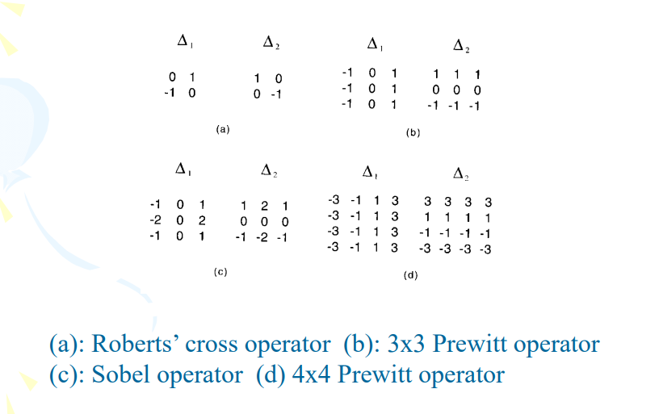
Solution Description
The facial recognition CNN will be developed and trained in a python environment with filter sizes of 2x2,3x3,4x4. The kernels for each being the roberts cross for the 2x2, Sobels operator for the 3x3 and Prewitt operator for the 4x4, these are also referenced in the figure below. Comparing resulting accuracy to find best results. The secondary variables will include the use of zero padding, one convolution layer, sigmoid activation function for the classification, one hidden layer in classification, and the use of max pooling.

Slide 18
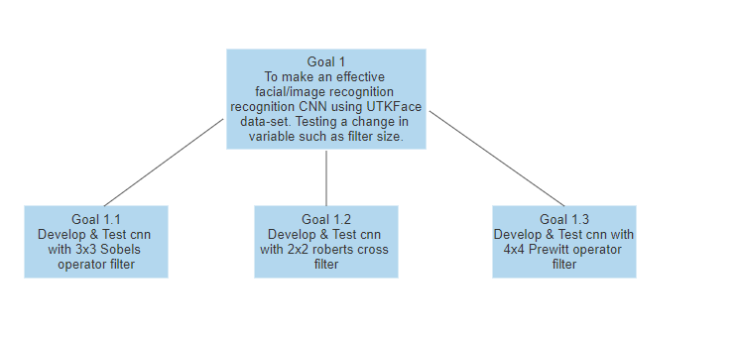
Goal Tree

Slide 19
Block Diagram
Factor | Values
Filter sizes | 2x2, 3x3, 4x4
Activation functions | Sigmoid (NN), RELU (CNN)
Images | Train with 20000 images Train with 18000 and test with 2000
Number of hidden layers in classification | 1
Number of Convolution Layers | 1
Padding Types | Zero Padding,No Padding
Number of Pooling Layers | 1
Pooling Types | Max

Slide 20
Additional Sources
https://www.renom.jp/notebooks/tutorial/beginners_guide/backpropagation_example/notebook.html
https://www.ics.uci.edu/~majumder/DIP/classes/EdgeDetect.pdf
https://medium.com/secure-and-private-ai-math-blogging-competition/cnn-maths-behind-cnn-910eab425b5d
https://towardsdatascience.com/the-most-intuitive-and-easiest-guide-for-convolutional-neural-network-3607be47480
https://stats.stackexchange.com/questions/226923/why-do-we-use-relu-in-neural-networks-and-how-do-we-use-it#:~:text=ReLU%20is%20the%20max%20function,function%20like%20tanh%20or%20sigmoid.
https://developers.google.com/machine-learning/practica/image-classification/convolutional-neural-networks
https://www.freecodecamp.org/news/an-intuitive-guide-to-convolutional-neural-networks-260c2de0a050/
https://hackernoon.com/everything-you-need-to-know-about-neural-networks-8988c3ee4491

